Slide 1
Introduction to Binomial Trees
Chapter 12

Slide 2
A Simple Binomial Model
A stock price is currently $20
In three months it will be either $22 or $18
Stock Price = $22
Stock price = $20
Stock Price = $18

Slide 3
A Call Option (Figure 12.1, page 269)
A 3-month call option on the stock has a strike price of 21.
Up Move
Stock Price = $22
Option Price = $1
Stock price = $20
Option Price=?
Stock Price = $18
Option Price = $0
Down Move

Slide 4
Setting Up a Riskless Portfolio
For a portfolio that is long Δ shares and a short 1 call option values are
Portfolio is riskless when 22Δ – 1 = 18Δ or Δ = 0.25
Up Move
22Δ – 1
Down Move
18Δ

Slide 5
Valuing the Portfolio
(Risk-Free Rate is 12%)
The riskless portfolio is:
long 0.25 shares short 1 call option
The value of the portfolio in 3 months is 22 × 0.25 – 1 = 4.50
The value of the portfolio today is 4.5e ^{– 0.12×0.25} = 4.3670

Slide 6
Valuing the Option
The portfolio that is
long 0.25 shares short 1 option
is worth 4.367
The value of the shares is 5.000 (= 0.25 × 20 )
The value of the option is therefore 0.633 (= 5.000 – 4.367 )

Slide 7
Generalization (Figure 12.2, page 270)
A derivative lasts for time T and is dependent on a stock
S₀u
ƒ_{u}
Up Move
S₀
ƒ
S₀d
ƒ_{d}
Down Move

Slide 8
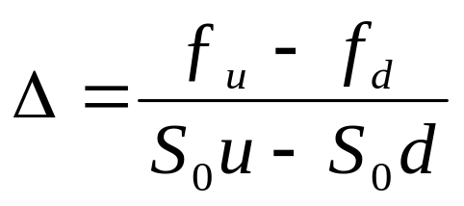
Generalization (continued)
Value of a portfolio that is long Δ shares and short 1 derivative:
The portfolio is riskless when S₀uΔ – ƒ_{u} = S₀dΔ – ƒ_{d} or
Up Move
S₀uΔ – ƒ_{u}
Down Move
S₀dΔ – ƒ_{d}

Slide 9
Generalization
(continued)
Value of the portfolio at time T is S₀u Δ – ƒ_{u}
Value of the portfolio today is (S₀u Δ – ƒ_{u} )e^{–rT}
Another expression for the portfolio value today is S₀Δ – f
Hence ƒ = S₀Δ – (S₀u Δ – ƒ_{u} )e^{–rT}

Slide 10
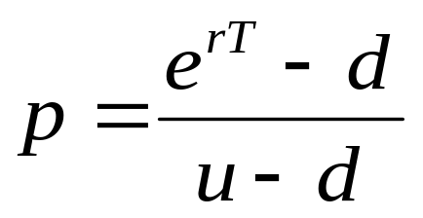
Generalization
(continued)
Substituting for Δ we obtain
ƒ = [ pƒ_{u} + (1 – p)ƒ_{d} ]e^{–rT}
where

Slide 11
p as a Probability
It is natural to interpret p and 1−p as the probabilities of up and down movements
The value of a derivative is then its expected payoff in discounted at the risk-free rate
S₀u
ƒ_{u}
p
S₀
ƒ
S₀d
ƒ_{d}
(1 – p )

Slide 12
Risk-Neutral Valuation
When the probability of an up and down movements are p and 1-p the expected stock price at time T is S₀e^{rT}
This shows that a holder of the stock earns the risk-free rate on average
The probabilities p and 1−p are consistent with a risk-neutral world where investors require no compensation for the risks they are taking

Slide 13
Risk-Neutral Valuation continued
The one-step binomial tree illustrates the general result that we can assume the world is risk-neutral when valuing derivatives.
Specifically, we can assume that the expected return on the underlying asset is the risk-free rate and discount the derivative’s expected payoff at the risk-free rate

Slide 14
Irrelevance of Stock’s Expected Return
When we are valuing an option in terms of the underlying stock the expected return on the stock (which is given by the actual probabilities of up and down movements) is irrelevant

Slide 15
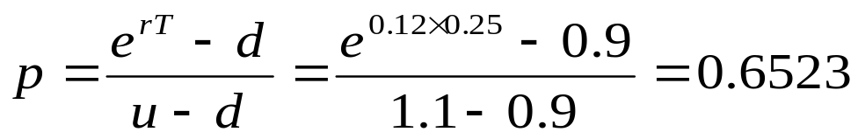
Original Example Revisited
S₀u = 22
ƒ_{u} = 1
p
S₀
ƒ
S₀d = 18
ƒ_{d} = 0
Since p is a risk-neutral probability 20e^{0.12 ×0.25} = 22p + 18(1 – p ); p = 0.6523
(1 – p )

Slide 16
Valuing the Option Using Risk-Neutral Valuation
The value of the option is
e^{–0.12×0.25} [0.6523×1 + 0.3477×0]
= 0.633
S₀u = 22
ƒ_{u} = 1
0.6523
S₀
ƒ
S₀d = 18
ƒ_{d} = 0
0.3477

Slide 17
A Two-Step Example
Figure 12.3, page 275
Each time step is 3 months
K=21, r =12%
24.2
22
20
19.8
18
16.2

Slide 18
Valuing a Call Option
Figure 12.4, page 275
24.2
3.2
Value at node B = e^{–0.12×0.25}(0.6523×3.2 + 0.3477×0) = 2.0257
Value at node A = e^{–0.12×0.25}(0.6523×2.0257 + 0.3477×0)
= 1.2823
D
22
B
20
1.2823
2.0257
19.8
0.0
A
E
18
C
0.0
16.2
0.0
F

Slide 19
A Put Option Example
Figure 12.7, page 278
72
0
60
50
4.1923
1.4147
48
4
40
9.4636
32
20
K = 52, time step =1yr
r = 5%, u =1.32, d = 0.8, p = 0.6282

Slide 20
What Happens When the Put Option is American (Figure 12.8, page 279)
72
0
60
50
5.0894
1.4147
48
4
40
The American feature increases the value at node C from 9.4636 to 12.0000.
This increases the value of the option from 4.1923 to 5.0894.
C
12.0
32
20

Slide 21
Delta
Delta (Δ) is the ratio of the change in the price of a stock option to the change in the price of the underlying stock
The value of Δ varies from node to node

Slide 22
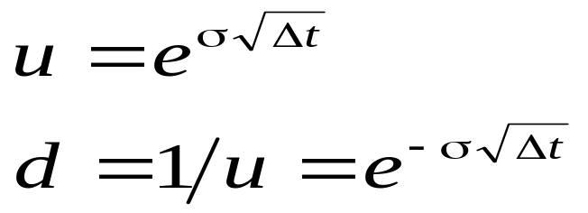
Choosing u and d
One way of matching the volatility is to set
where σ is the volatility and Δt is the length of the time step. This is the approach used by Cox, Ross, and Rubinstein (1979)

Slide 23
Assets Other than Non-Dividend Paying Stocks
For options on stock indices, currencies and futures the basic procedure for constructing the tree is the same except for the calculation of p

Slide 24
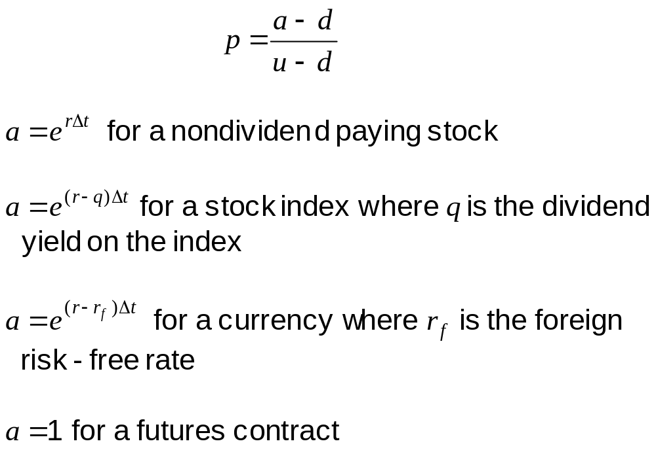
The Probability of an Up Move

Slide 25
Increasing the Time Steps
In practice at least 30 time steps are necessary to give good option values
DerivaGem allows up to 500 time steps to be used

Slide 26
The Black-Scholes-Merton Model
The BSM model can be derived by looking at what happens to the price of a European call option as the time step tends to zero
See Appendix to Chapter 12

